Slide 1
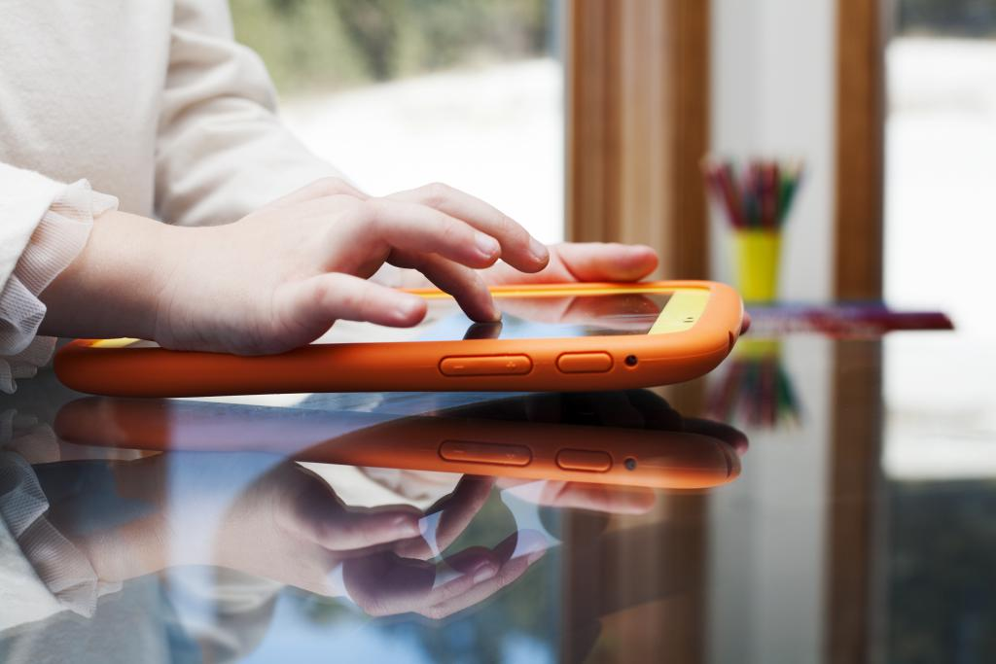
E Safety January 2022 – digital leaders

Slide 2
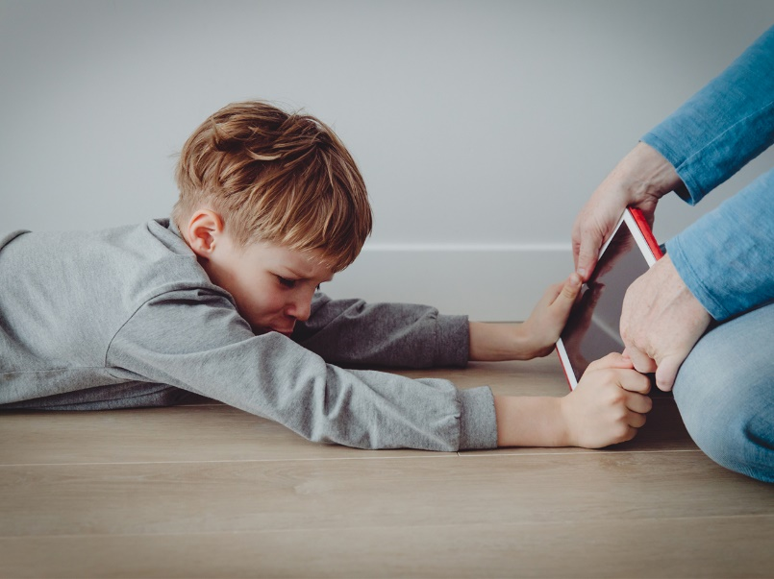
This half term’s focus is staying happy when we are online.

Slide 3
In our lessons, we will be looking at some of the problems with being online. Getting addicted Finding it hard to come off games. Being unkind to one another Not doing enough things which are good for us.

Slide 4
We will also be looking at some simple tips: Getting enough sleep time Devices off before bed No screens in room

Slide 5
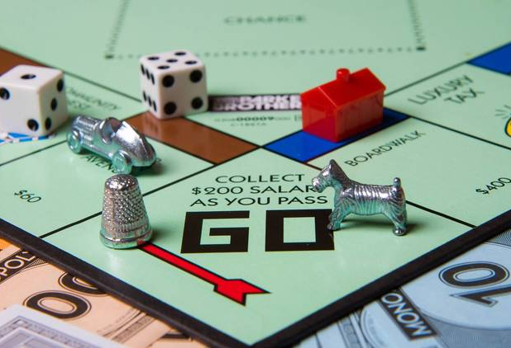
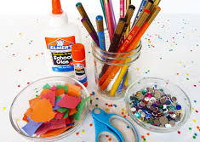
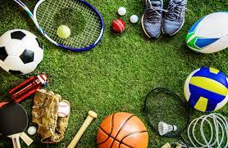
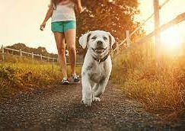
Instead of screen time you could:
Walk your dog (if you have one)
Learn something new
Exercise or spend family time
Get creative
Read/ do homework

Slide 6
And there will be a competition…..

